Slide 1
Keyword Extraction
Final presentation
ML presentation

Slide 2
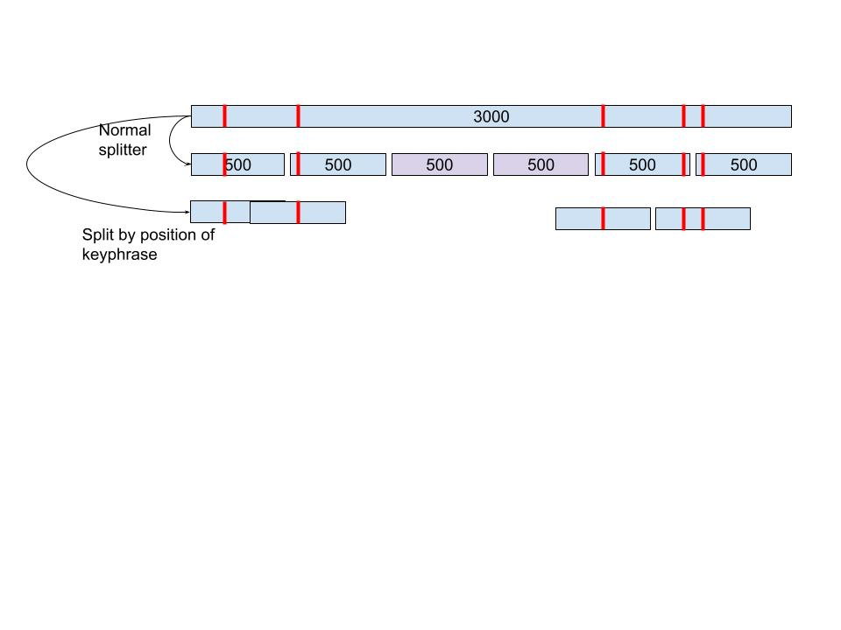
Research part
1. Recall from the last presentation
Given a document, the algorithm will find the key phrases that represent the main topics and ideas of the document.
Improvement performance using combination dataset.
Data splitting for long document datasets : kptimes and pubmed.

Slide 3
2. Compare performance on data splitting.
We have 4 datasets but only 2 dataset with long documents: kptimes and pubmed.
Pubmed training set contains 400 documents.
Kptimes training set contains 260.000 documents:
=> Increase to 545.517 documents using splitter.
=> Increase to 1.421.486 documents using position strategie.
Kptimes takes the major influence for training.
The evaluation is performed only on short document.
I combine all short document from all dataset to create a generalized dataset for evaluation.

Slide 4
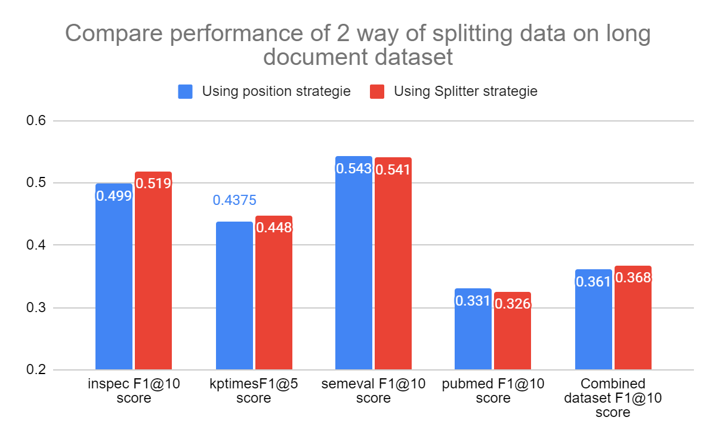
Both strategies give a very similar result but training time of position strategy is 3 times longer than splitter strategie ’s.
Conclusion: using combination of 4 dataset applying splitter strategy.

Slide 5
3. Casing vs Uncasing
Motivation : tokenizer casing considers a phrase of upper form and lower form as 2 different phrases. Hence, the model could lose the information that a phrase is repeated many times in document. For example : “We” and “we” are considered as 2 different ngram in casing.
=> Replace tokenizer and deep language model from Bert-base-cased by Bert-base-uncased.

Slide 6
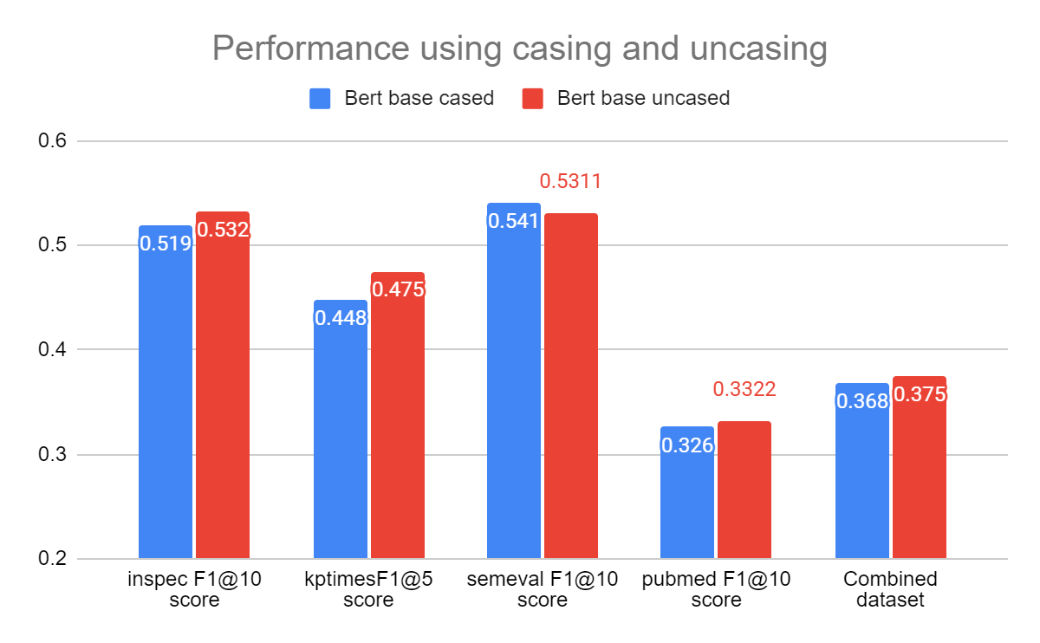
Increases F1@5 score of kptimes.
Conclusion: using uncased tokenization instead of cased

Slide 7
4. Using variant of Bert
Motivation: apply smaller versions of Bert to compare the performances and the gain in inference speed.
Comparison between: Bert-base, Distillbert, Bert-medium, Bert-small, Bert-mini

Slide 8
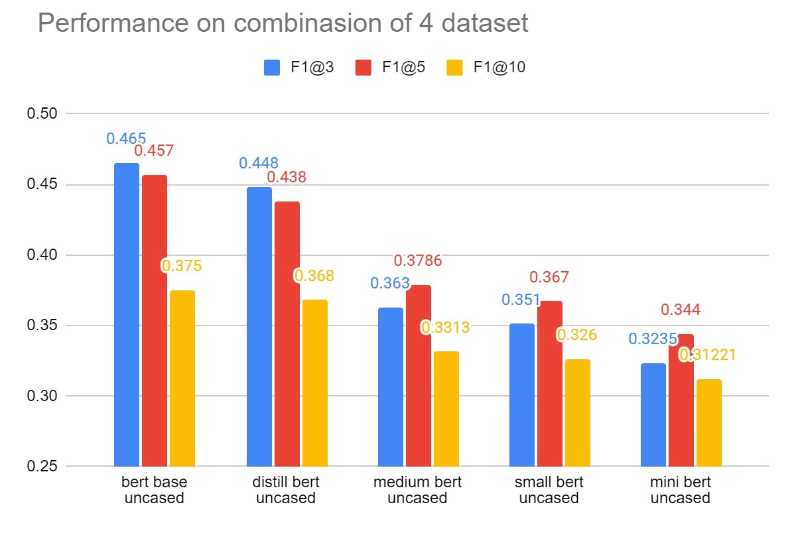

Slide 9
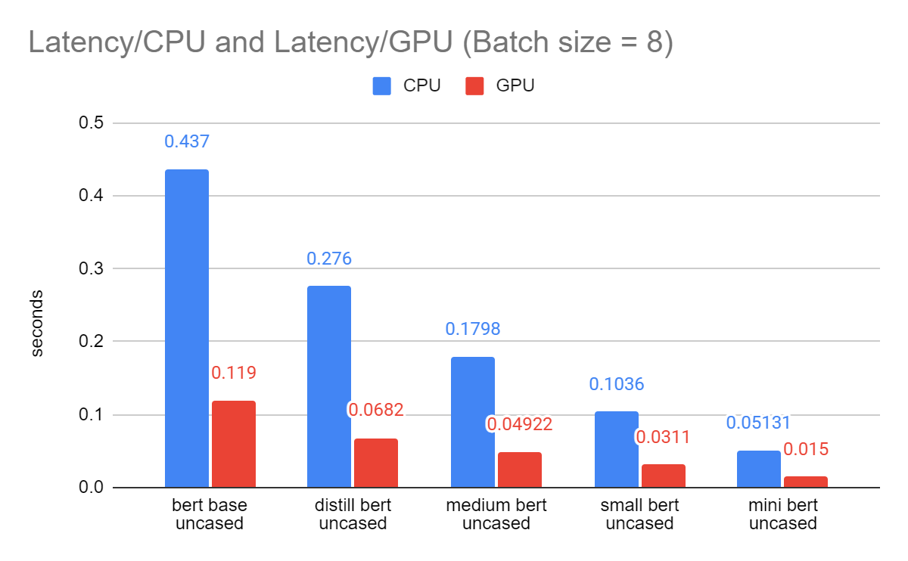

Slide 10
5. Inference long document
Without strategy, the model predicts the first 512 tokens of the documents.
Strategy in production: split the document by 512-tokens passages, without overlapping.
My strategy :
Split with overlap the documents into several passages
Extract keywords of each passage
As each keyword has a score, compute the sum the score for repeated keywords between the passages
Sort all keywords by score, get only the top max_candidates keywords

Slide 11
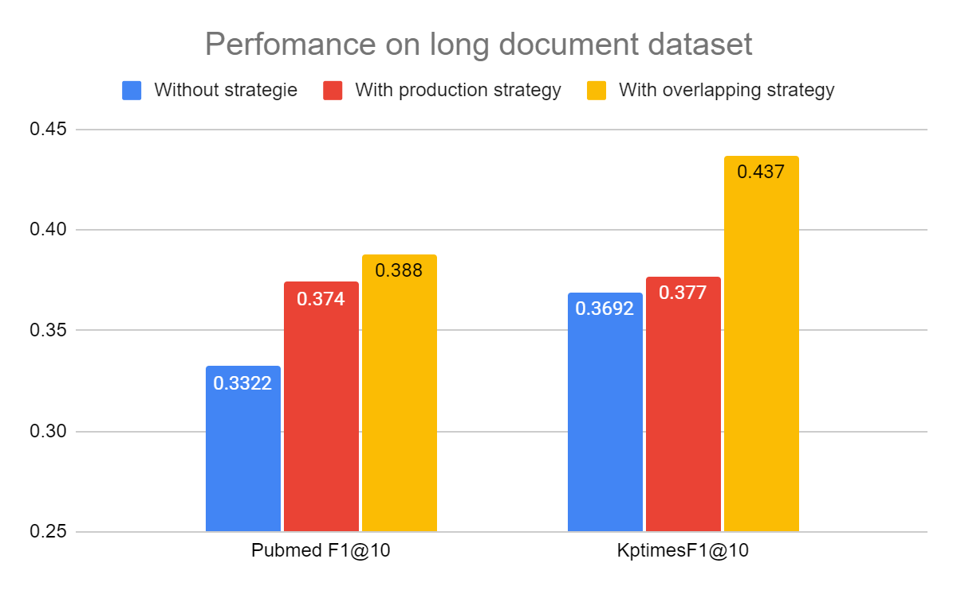

Slide 12
II. Integration part
Implement feature of keyword extraction in Sinequa production.
Reproduce the results computed using Python, on C#:
Reproduce pre and post processing.
Implement a serving method based on onnx model file.
Construct an architecture to manage model by name.
Integrate the feature into 2 main functionalities: serving routes and sinequa command

Slide 13
Serving function
Preprocessing
Serving
Postprocess
Filter punctuations, extra space and unexpected characters
Tokenize
Split long documents if needed and batchify
Build input feature
Use an instance of DlModel
Contain input feature in DlData
Calculate the result
Concatenate the result of passage from same document.
Extract top k ngram as keywords.
Stemminize and filter the repeated keywords.
Get a set of keywords for each document.

Slide 14
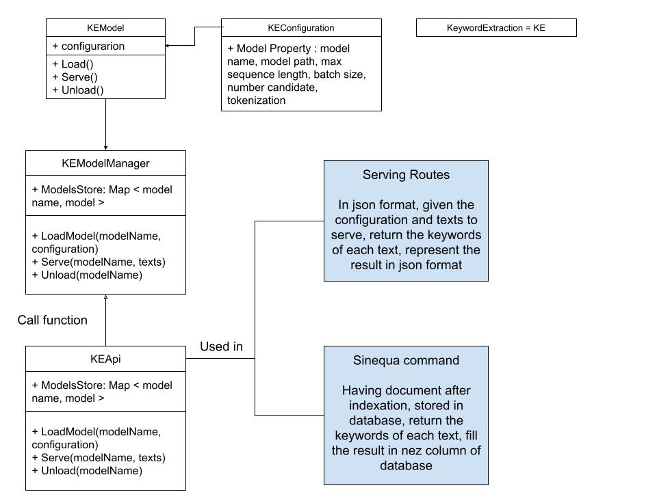

Slide 15
Thank You!
with the most complete Enterprise Search, ever.

